Slide 2
Introduction
Dogs and wolves belong to the same family. Rather dogs have evolved from wolves. Another fact is that over the centuries, wild animals have been mastered and tamed by man. This story informs us how a dog changed to a tamed animal.

Slide 3
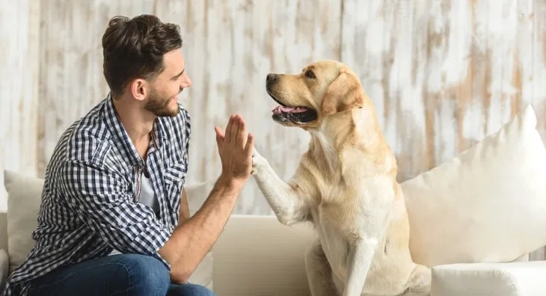

Slide 4
Summary
In olden times, dogs, just like wolves were forest dwellers. They were bold, free and were not afraid of anyone. They were their own masters. Then one day, a dog who was sick and was scared of other stronger animals decided to look for a master who was the strongest on this earth.
To find his master, he began his search and first of all, he met a big wolf. He asked him if he would like to be his master. The wolf accepted him as a servant.

Slide 5
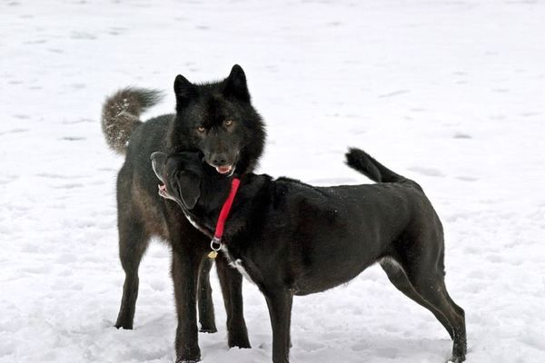

Slide 6
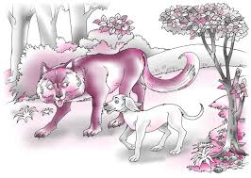

Slide 7
Summary
Both of them started walking and on the way they met a bear. The wolf tried to hide himself as soon as he noticed the bear.
On enquiring the reason, the dog came to know that the wolf considered the bear to be stronger than him. On this, the dog left him and joined the bear.

Slide 8
Summary
Very soon, the dog found that the bear was afraid of the lion.
The dog immediately left him and went to the lion. The lion agreed to accept him as his servant. The dog lived with him happily for a long time as he enjoyed a secure and happy life, the way he wanted. The lion was the strongest animal in the forest. Once, both of them were strolling amongst the rocks on a narrow path. Suddenly, the lion saw a man and he asked the dog to run away with him to avoid any trouble.

Slide 9
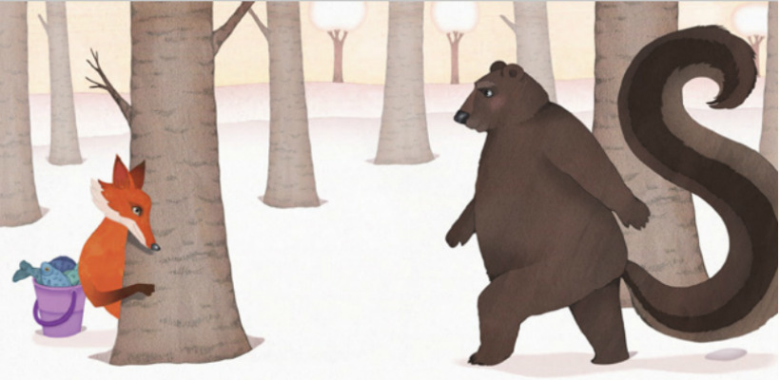

Slide 10
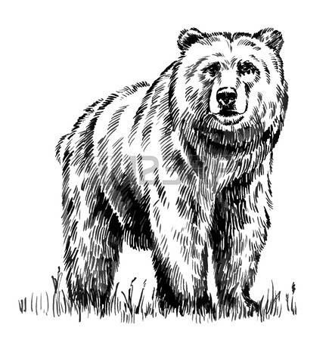

Slide 12
Summary
Very soon, the dog found that the bear was afraid of the lion.
As soon as the dog realized that man was the strongest creature on the earth, he bid adieu to the lion as well.
Dog came to man as his servant and lived as a faithful servant to him then after.

Slide 13
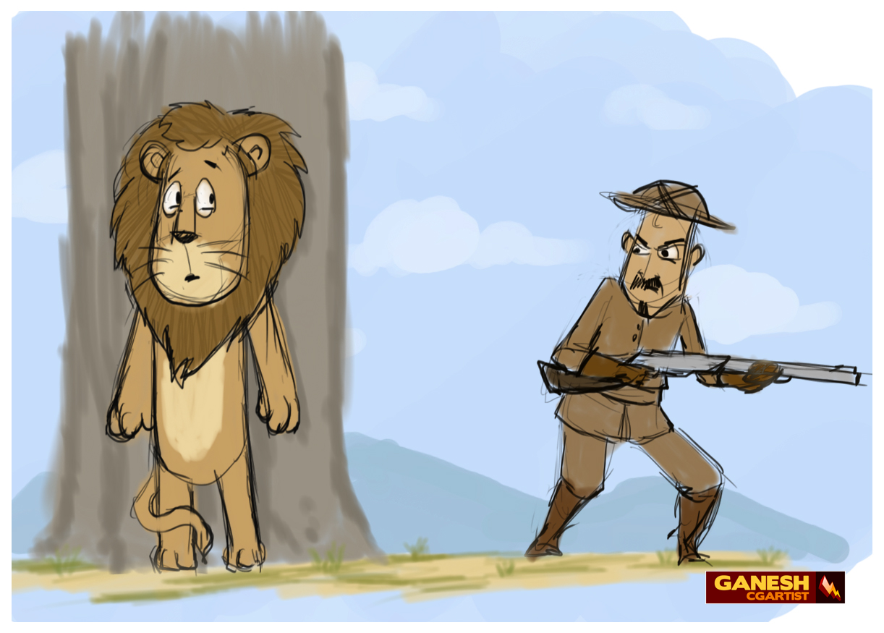

Slide 14
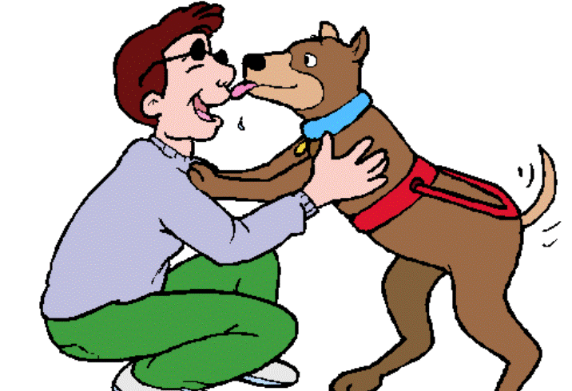

Slide 15
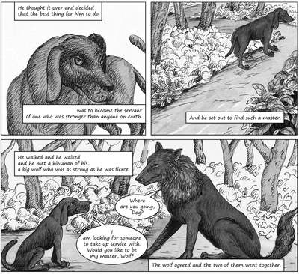

Slide 16
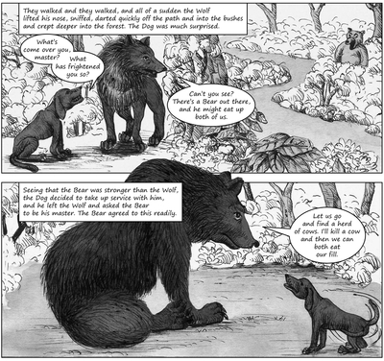

Slide 17
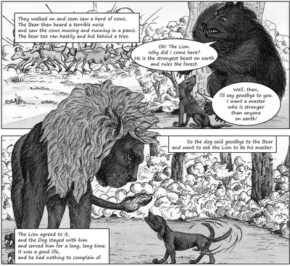

Slide 18
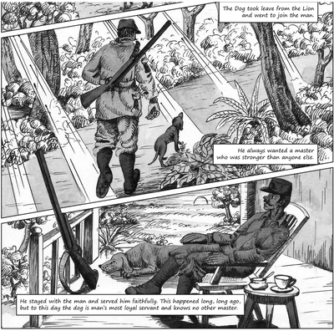

Slide 19
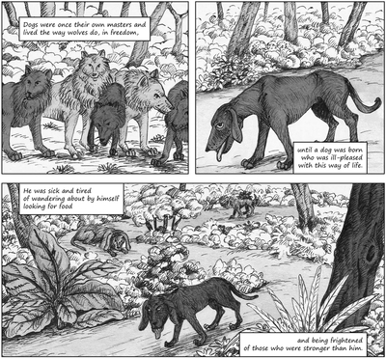

Slide 20
ill pleased: old fashioned way of saying not happy Freedom: liberty , without any constraints, wandering: to move here and there aimlessly frightened: afraid of
servant: attendant, helper, who works for others Master: owner, ruler, sovereign

Slide 21
kinsman: (old fashioned word for) a relative fierce: violent; frightening take up service with: become the servant of
darted: moved quickly suddenly come over you: affected you Sniffed: draw up air audibly through the nose to detect something
herd of cows: a group of cows mooing: sound made by cows terrible: horrible in a panic: a strong feeling of fear

Slide 22
Hastily : hurriedly beast: animal behind : at the back side of something
cliff: a steep, high rock (often at the edge of the sea) bare: unclothed

